Slide 1
Uninformed/Blind Search
BBM 405 – Fundamentals of Artificial Intelligence
Pinar Duygulu
Hacettepe University
Slides are mostly adapted from AIMA, MIT Open Courseware,
Manuela Veloso(CMU) and
Svetlana Lazebnik (UIUC)

Slide 2
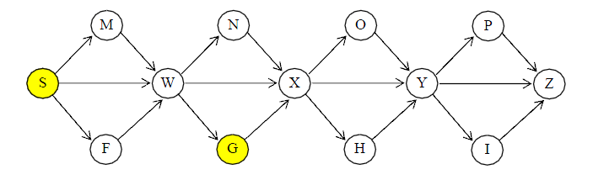
Example1
Your job is to find a path from the Start node, S, to the Goal node, G,
using various algorithms under various conditions.
All streets are one-way, left to right.
In the event any search reaches a point where you need to break a tie,
use this rule: a path that terminates in a node closer to the top of the page
takes precedence over another that terminates in a node that is less close;
if there is still a tie, a path that terminates in a node closer to the
left of the page takes precedence over another that terminates in a node
that is less close.

Slide 3
Depth first search
Perform depth-first-search. Do not use a visited list.
Do not expand any partial path to a node that it already contains.
Use the convention that a path to the goal is only returned when the goal
node is expanded, not as soon as it appears in the queue.
- Write down all the nodes expanded, in the order in they are expanded
- Give the full path that is returned.

Slide 4
Breadth first search
You are to perform breadth-first-search.
Do not use a visited list.
Do not extend any partial path to a node that it already contains.
Use the convention that a path to the goal is only returned when the
goal node is expanded, not as soon as it appears in the queue.
-Write down all the nodes expanded, in the order in they are expanded.
-Give the full path that is returned.

Slide 5
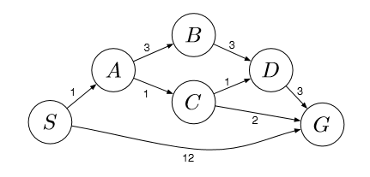
Example 2
What path would breadth-ﬁrst graph search return for this problem?
What path would uniform cost graph search return for this problem?
What path would depth-ﬁrst graph search return for this problem?

